Slide 1
Boston House Price Prediction
By : - Suraj Ghorpade

Slide 2
CONTENT
Problem Statement
Import dataset – Feature Information
EDA/Feature Engineering(slide 6 to slide 10)
Feature Selection
Model Building
Evaluation

Slide 3
Problem Statement
House Price Predication
Given data is labeled
Apply different algorithm of machine learning for predictive modeling

Slide 4
Feature Information
Boston House Prices Dataset was collected in 1978 and has 506 entries with 15 attributes or features for homes from various suburbs in Boston.
Boston Housing Dataset Attribute Information (in order):
- CRIM per capita crime rate by town
- ZN proportion of residential land zoned for lots over 25,000 sq.ft.
- INDUS proportion of non-retail business acres per town
- CHAS Charles River dummy variable (river bound= 1 if tract bounds river; 0
otherwise)
- NOX nitric oxides concentration (parts per 10 million)
- RM average number of rooms per dwelling
- AGE proportion of owner-occupied units built prior to 1940
- DIS weighted distances to five Boston employment centres
- RAD index of accessibility to radial highways
- TAX full-value property-tax rate per $10,000
- PTRATIO pupil-teacher ratio by town
- Black (Bk - 0.63)^2 where Bk is the proportion of blacks by town
- LSTAT % lower status of the population
- MEDV Median value of owner-occupied homes in $1000's

Slide 5
Dataset info :-
Samples: 506
Features: 15
Categorical features: 0
Numeric Features: 15

Slide 6
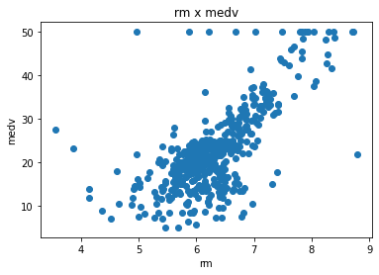
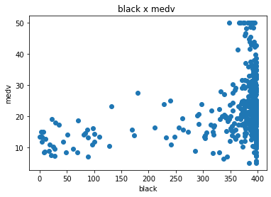
Correlation between Indep. Var And dep. Var.
Correlation between “rm” and “medv” looking more than others feature so it is imp feature than others
Correlation between “black” and “medv” is less as compare to others feature so we drop the “black” feature due to less impact on target var.

Slide 7
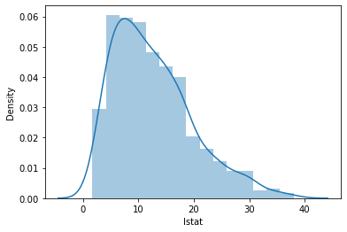
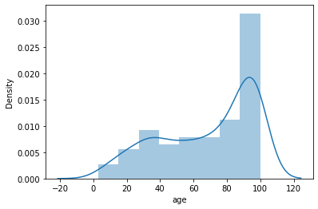
Skewness has been not observed in above distributions
Distribution of lstat feature
Distribution of age feature

Slide 8
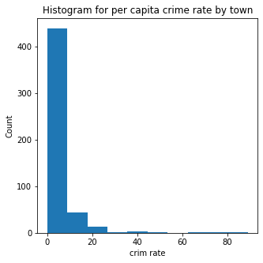
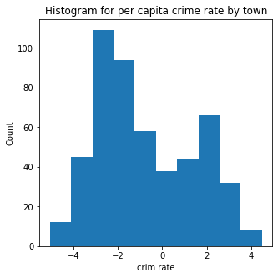
Skewness has been observed in distribution of crim rate which can be removed with log transformation
Distribution of crim rate
Distribution after Log Transformation on crim rate

Slide 9
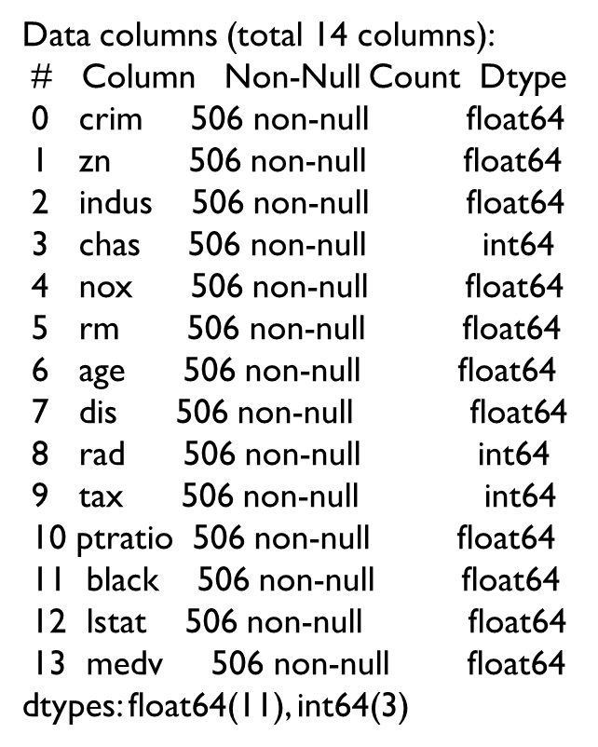
Missing Values
Datatype (Encoding Purpose)
crim 0
zn 0
indus 0
chas 0
nox 0
rm 0
age 0
dis 0
rad 0
tax 0
ptratio 0
black 0
lstat 0
medv 0
dtype: int64
No any missing values so no problem arises for fill up or drop any rows values
There are no categorical variable so no need of encoding technique

Slide 10
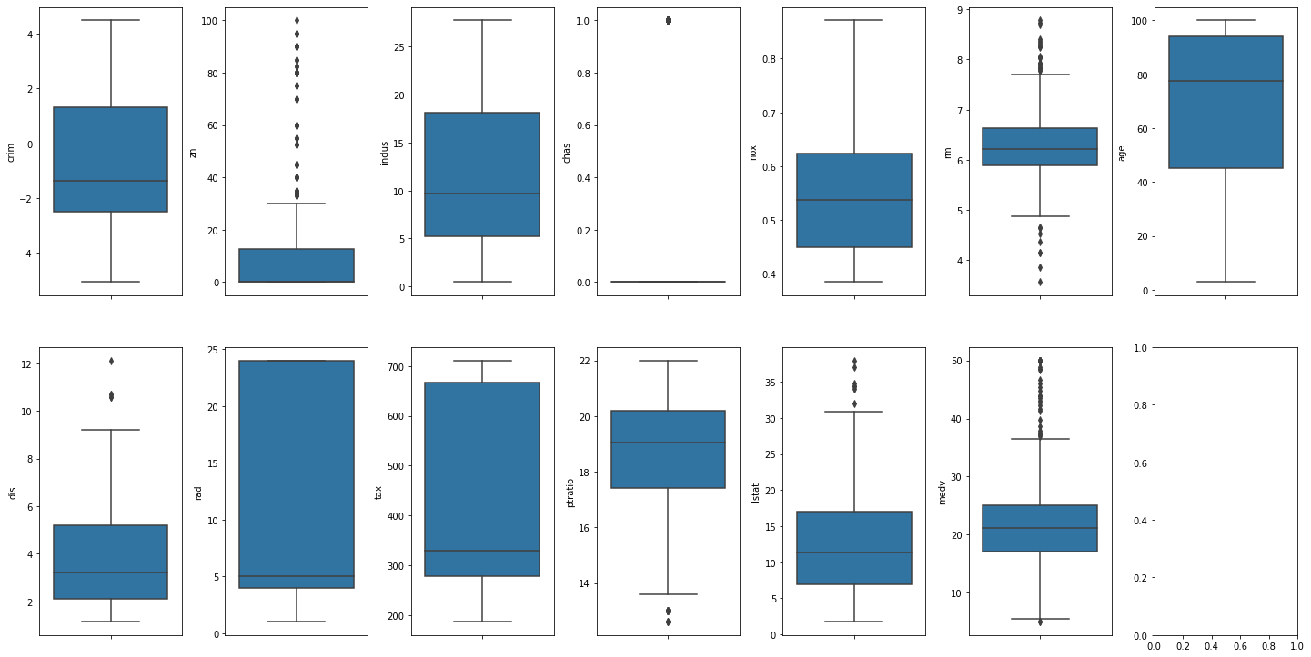
Outlier Detection
for [“zn” , “rm”] have outlier so for this scenario we used RobustScaler: Scales features using statistics that are robust to outliers.This scaler removes the median and scales the data according to the quantile range

Slide 11
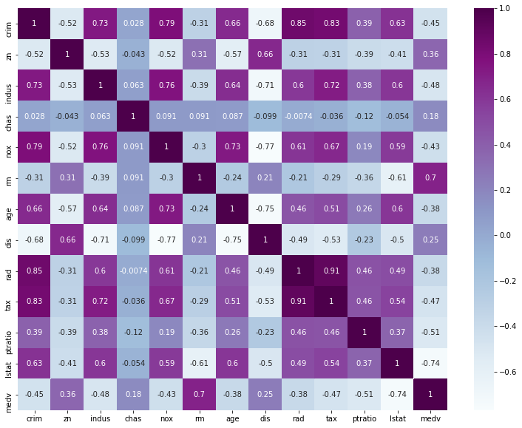
Feature Selection
Correlation Matrix : -
As per correlation heatmap rm and lstat are most correlated with target feature (medv) other than independent feature. Only we dop black feature which not correlated . There are no categorical variable so need of different statical test like annova ,chi-square test.

Slide 12

Model Building and Evalutions
Train-Test Split: (75%,25%)
Model No | Algorithm Name | R-squared Score | MAE
1 | Linear regression | 70.45 | 2.9714
2 | Random forest Regressor | 86.10 | 2.0898
3 | Adaboost Regressor | 75.30 | 2.7795
4 | Xgb Regressor | 85.79 | 2.0750

Slide 13
Thank You

